Slide 1
Cyber Hacking Breaches Detection And Prediction Using Machine Learning
Guide Name:
Ms.V.Saranaya,M.E
Presented By:
Anisuthan S -71052202007
Angeshkumar P-71052202301
Nathesh PV-71052202303
Sanjayram S-71052202308

Slide 2
Introduction:
XG-Boost-Based Intelligent URL Security System:
This project presents an advanced cybersecurity model designed to predict and detect cyber threats by analyzing URL characteristics.
The system is crafted to provide:
Accurate future threat prediction
Real-time malicious URL detection
Live monitoring dashboard

Slide 3
Problem Statement:
Why This Project Is Important:
Modern cybersecurity faces major challenges due to the rapid growth of digital platforms:
Cyberattacks are rising rapidly with increasing digital usage.
Many breaches begin with phishing or malicious URLs.
Users are often tricked into revealing sensitive information.
Traditional security tools detect threats only after damage occurs.

Slide 4
Solution Overview:
The system uses Machine Learning to secure users from harmful URLs.
It has two key modules:
Prediction and Detection:
The Prediction Module analyzes URL patterns to identify future threats.
It generates a risk probability score to support preventive security actions.
The Detection Module scans URLs in real time to spot malicious or suspicious links.
Together, both modules provide strong proactive and reactive cybersecurity protection.

Slide 5
Objectives:
Develop ML models for accurate malicious URL prediction and detection
Implement real-time threat analysis with sub-second response times
Create proactive threat forecasting capabilities
Build comprehensive analytics for security intelligence
Design user-friendly interface for enterprise deployment

Slide 6
XG-Boost
What is XGBoost?
Extreme Gradient Boosting - Advanced machine learning algorithm
Ensemble Method - Combines multiple weak models to create strong predictions
Winning Solution - Dominates Kaggle competitions and real-world applications Why XGBoost for URL Security?
Speed & Performance
10x Faster than traditional algorithms
Parallel Processing handles large datasets efficiently
Real-time Predictions crucial for instant threat detection

Slide 7
Prediction Module:
Future Threat Prediction:
The prediction module focuses on proactive cybersecurity, enabling organizations to stay ahead of threats:
Extracts and analyzes historical URL behavior and structure.
Predicts possibility of future harm by identifying suspicious patterns.
Assigns a risk score (0–100%) that categorizes URLs into:
Low Risk
Medium Risk
High Risk
Allows security teams to take action before a harmful URL is used in phishing or fraud campaigns.

Slide 8
Detection Module:
Real-Time Cyber Threat Identification:
The detection module safeguards users by providing instant protection:
Immediately scans a URL when a user enters or clicks it.
Examines structure, keywords, domain properties, SSL certificates, and more.
Detects phishing, malware delivery, and fraudulent behavior.
Produces:
A threat score
Threat classification (Safe / Suspicious / Malicious)
Triggers instant alerts to warn users or administrators.

Slide 9
System Architecture Design
FRONTEND (User Interface): Framework: HTML5, CSS3, JavaScript Templates: Home, Login, Module Selection Prediction & Detection Interfaces Real-time Analytics Dashboards Features: Responsive Web Design Interactive Threat Visualization Live Security Metrics Display | BACKEND (Server & Processing) Framework: Flask Python API Core Components: Authentication & Session Management RESTful API Endpoints Rate Limiting & Security Middleware Database: SQLite with Analytics Storage

Slide 10
System Architecture Design
ALGORITHM (Machine Learning Core) Technology: XGBoost Ensemble Learning Dual ML Models: Detection Model (Real-time Analysis) Prediction Model (Future Threat Forecasting) Feature Engineering: 15+ URL Parameters Analyzed Structural, Content & Security Features | OUTPUT & DISPLAY Real-time Results Threat Scores (0-100) Risk Levels (Low-Critical) Probability Percentages Visual Analytics Interactive Charts Threat Maps Performance Dashboard Actionable Intelligence Security Recommendations Preventive Measures Historical Analysis

Slide 11
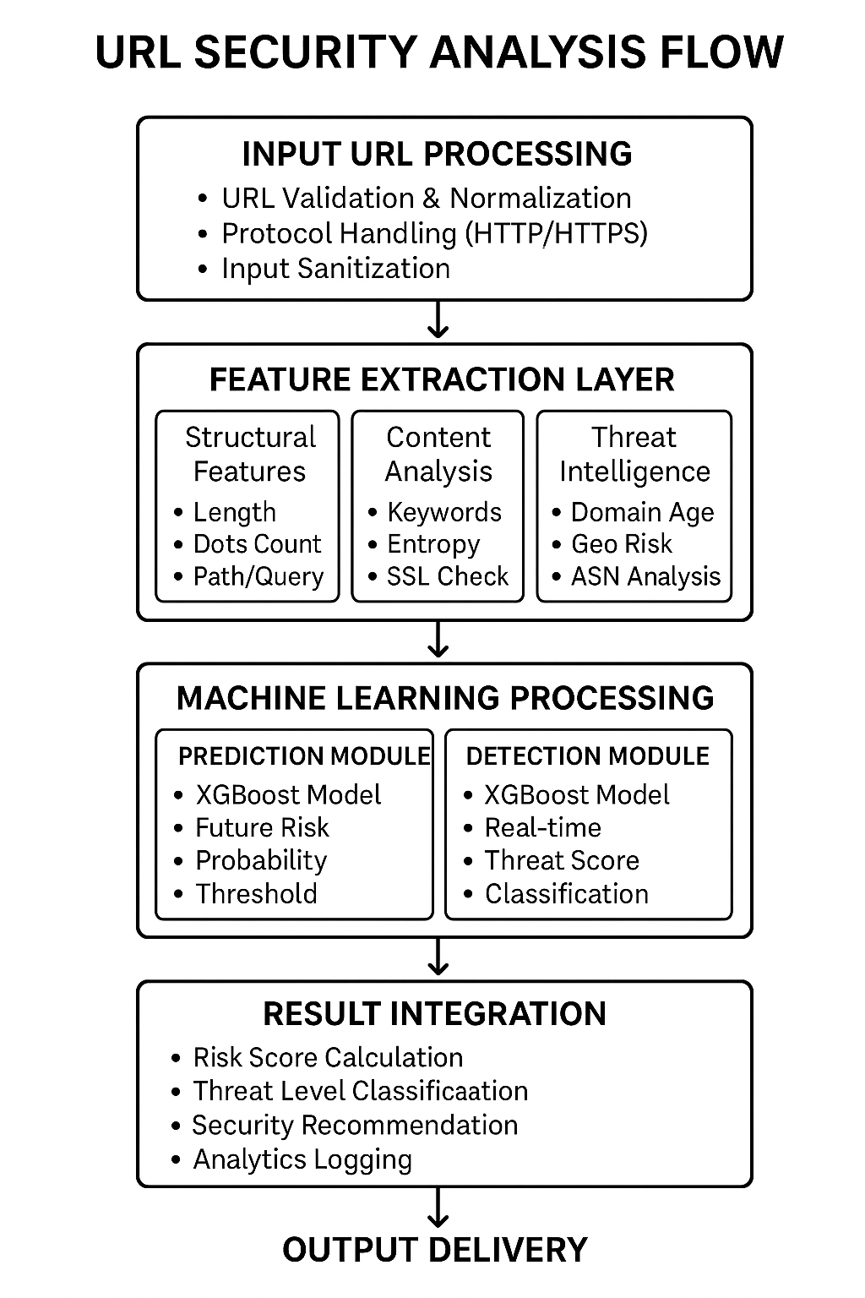
Flow Chart

Slide 12
Key Features and Benefits:
ML-based future risk prediction Real-time malicious URL detection Interactive analytics dashboard Automated protection with minimal manual effort Lightweight, fast, and enterprise-ready | Fewer security breaches Faster response to threats Safer browsing for users Scalable for large systems Continuous learning for higher accuracy

Slide 13
Future Enhancements:
Modular Design - Six specialized components (Authentication, Dashboard, URL Input, etc.) ensure organized, maintainable code.
Complete User Journey - Handles everything from URL input and analysis to interactive results visualization and reporting.
Enterprise Management - Full administrative control with user management, system monitoring, and configuration settings

Slide 14
Conclusion:
Why This Project Is Valuable:
Combines prediction + detection, offering holistic security.
Uses XG-Boost, one of the most powerful ML algorithms.
Provides real-time threat analysis with high accuracy.
Easy to use, scalable, and adaptable to new cyber threats.
Helps individuals and companies stay safe in an increasingly dangerous digital world.

Slide 15


